Slide 1
CSC 230 - Introduction to Web Development
Mon/Wed 1:00 PM - 4:00 PM
SMU Lacey, Panowicz Hall, Room 104

Slide 2
Contact Information
Name: Dr. Guangyan Li
Email: gli@stmartin.edu
Telephone: (360) 688-2749 (office), (360) 525-3988 (cell)
Communication: phone or email
Office Hours: see Moodle General Section for posted office hours. Also available at almost any time for virtual office hours, text or email me.
Office Location: Panowicz Hall Room 111 or online via Zoom by clicking here directly.

Slide 3
Course Description
This introductory course starts with how the web works and covers key web development concepts, enabling the student to understand what it takes to build a web application. Back-end and front-end development are covered, and students will gain fundamental knowledge to create simple web pages.

Slide 4
Course Objectives
By the conclusion of this course, students are expected to:
Learn web development basics using HTML, CSS and JavaScript
Learn HTML basics and describe HTML features
Style HTML pages using CSS, Vector Graphics, Animation
Create well-structured, clean, JavaScript code
Understand the HTML DOM (Document Object Model) and use JavaScript to interact with DOM
Learn the basics of front-end JavaScript library React and use it create simple user interfaces
Understand Model-View-Controller (MVC) design pattern, and apply it web development
Build simple web-based applications using full stacks such as MERN (MongoDB, Express, React, and Node)

Slide 5
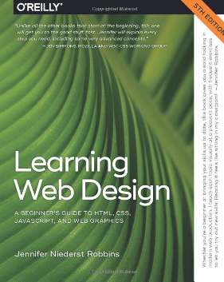
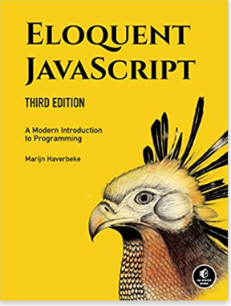

Books & Additional Readings
· Learning Web Design: A Beginner's Guide to HTML, CSS, JavaScript, and Web Graphics, by Jennifer Robbins, O'Reilly Media; 5th edition (2018) ISBN-13: 978-1491960202 – main textbook!
· Eloquent JavaScript, 3rd Edition A Modern Introduction to Programming, by Marijn Haverbeke; 3rd edition (2018) ISBN-13: 9781593279509 https://eloquentjavascript.net/
· Beginning MERN Stack: Build and Deploy a Full Stack MongoDB, Express, React, Node.js App, by Greg Lim; 1st edition (2021) ISBN-13: 979-8523625503

Slide 6
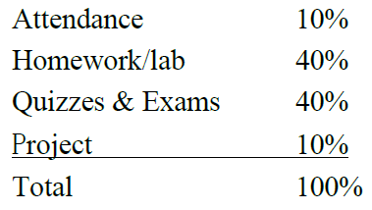
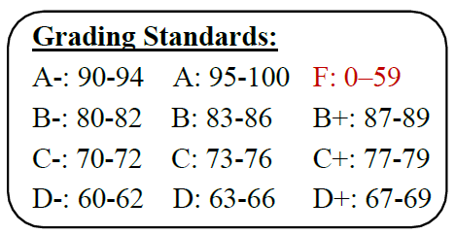
Assessment Methods

Slide 7
Tentative Schedules and Learning Outcomes
Week 1 | Set the expectations for the class Install the required software tools Introduce the basics of HTML and CSS
Week 2 | Learn the fundamentals of CSS Create and style web pages using HTML and CSS
Week 3 | Learn the fundamentals of JavaScript Learn to create objects and methods using JavaScript
Week 4 | Introduce the front-end tool React & React Architecture Lean how to create a React applications
Week 5 | Introduce a popular full-stack – MERN stack (MongoDB, Express, React, Node) Learn MVC (Model View Controller) structure
Week 6 | Develop simple web application project using MERN stack
Week 7 | Brief introduction of other web frameworks such as Java Spring Boot, Python Django
Week 8 | Group project presentation & documentation Final exams

Slide 8
Attendance and More
You are expected to attend each class meeting. I found it is the best way to engage you in learning the course materials.
Students absent from an announced quiz or examination, unless excused, may not be permitted to make up quizzes or examinations.
For each 4 unexcused absences (that is two weeks’ worth of classes) your grade may decrease by a letter grade.
You are expected to keep the instructor informed of any changes or issues that may prevent you from completing your assignments or this course.
You’re strongly encouraged to take advantage of my office hours. I’m available other times but you need email/call me in advance.
You are expected to check your SMU email at least once a day. This will be the way I will try to reach you.

Slide 9
How to Get Started with Moodle
Visit: http://moodle.stmartin.edu
See “Getting Started with Moodle,” “Tutorials for Students,” and “Frequently Asked Questions” in the pane entitled “NAVIGATION” in the left margin.
LOGIN with your Saint Martin’s username and password when ready. For username and password help, see: https://www.stmartin.edu/directory/integrated-technology-services/technology-help

Slide 10
Standard St. Martin's information
Helpful Links
· Link to Saint Martin’s undergraduate Academic Catalog 2023-2024
https://www.stmartin.edu/documents/undergrad-academic-catalog-2023-24
· Link to Student Handbook currently in use (August 2023):
https://www.stmartin.edu/documents/student-handbook
· Link to the Office of Public Safety:
https://www.stmartin.edu/directory/offices-departments-directory/office-public-safety
· Link to the Emergency Preparedness site:
https://www.stmartin.edu/directory/offices-departments-directory/office-public-safety/emergency-preparedness
· Link to Office of Registrar:
https://www.stmartin.edu/directory/offices-departments-directory/office-registrar

Slide 11
Access and Accommodations
Your experience in this class is important to me. If you have already established accommodations with Disability Support Services (DSS), please communicate your approved accommodations to me at your earliest convenience so we can discuss your needs in this course.
If you have not yet established services through DSS, but have a temporary health condition or permanent disability that requires accommodations (conditions include but are not limited to mental health, attention-related, learning, vision, hearing, physical or health impacts), you are welcome to contact DSS at 360-438-4580 or dss.testing@stmartin.edu or smu.dss@stmartin.edu. DSS offers resources and coordinates reasonable accommodations for students with disabilities and/or temporary health conditions. Reasonable accommodations are established through an interactive process between you, your instructor(s) and DSS. It is the policy and practice of the Saint Martin’s University to create inclusive and accessible learning environments consistent with federal and state law.

Slide 12
Center for Student Success
The Center for Student Success offers free academic services for all Saint Martin’s students. The Center provides subject-area peer tutoring in science, technology, nursing, engineering, math, business, accounting, economics, world languages and other subjects. At the Writing Center, students meet with writing tutors to discuss their academic, personal, and professional writing. The Advising Center works with students on academic advising, connecting with campus support resources, transition and self-exploration guidance, personalized academic improvement plans, learning workshops, and support for changing majors. Disability Support Services is also located in the Center for any student with a disability who needs accommodations. For more information on the Center for Student Success, or to sign up for a tutoring, advising, or DSS meeting, see the website: https://stmartin.libcal.com/appointments

Slide 13
Counselling and Wellness Center
There may be times, as a college student, when personal stressors interfere with your academic performance and your daily life. The Counseling and Wellness Center supports students by addressing mental and emotional well-being with FREE and confidential services. To schedule an appointment, call 360-412-6123 or email counselingcwc@stmartin.edu or stop by the CWC (1st floor St. Raphael Center).
If you would rather not go to the CWC or need support in the evenings and weekends, please consider using the TimelyCare app (timelycare.com/smusaints) to speak with a mental health provider, free, 24/7, from your phone or computer.
Saints Care
Faculty, staff, students, and community members are welcome to submit a Saints Care Report at https://www.stmartin.edu/current-students/saints-care

Slide 14
Sexual Misconduct/Sexual Harassment Reporting
Saint Martin’s University is committed to providing an environment free from sex discrimination, including sexual harassment and sexual violence. There are Title IX/sexual harassment posters around campus that include the contact information for confidential reporting and formal reporting. Confidential reporting is where you can talk about incidents of sexual harassment and gender-based crimes including sexual assault, stalking, and domestic/relationship violence. This confidential resource can help you without having to report your situation to the formal reporting process through the Dean of Students – Ms. Melanie Richardson, Associate VP of Human Resources – Ms. Cynthia Johnson, Public Safety – Ms. Sharon Schnebly, or the Office of the Provost – Dr. Tanya Smith-Brice, unless you request that they make a report. Please be aware that, in compliance with Title IX and under the Saint Martin’s University policies, educators must report incidents of sexual harassment and gender-based crimes including sexual assault, stalking, and domestic/relationship violence. If you disclose any of these situations in class, on papers, or to me personally, I am required to report it.

Slide 15
Academic Honesty/Professionalism
WHAT IS ACADEMIC INTEGRITY? Saint Martin’s University is a community of faculty, students and staff engaged in the exchange of ideas in the ongoing pursuit of academic excellence. Essential to our mission is a focused commitment to scholarly values and intellectual integrity, and a respect for the ideas, beliefs and work of others. This commitment extends to all aspects of academic performance. All members are expected to abide by ethical standards both in their conduct and their exercise of responsibility to themselves and toward other members of the community. As an expression of our shared belief in the Benedictine tradition, we support the intellectual, social, emotional, physical and spiritual nurturing of students.
WHAT IS ACADEMIC DISHONESTY? Saint Martin’s University defines academic dishonesty as violating the academic integrity of an assignment, test and/or evaluation of any coursework. This dishonest practice occurs when you seek to gain for yourself or another an academic advantage by deception or other dishonest means. You have a responsibility to understand the requirements that apply to particular assessments and to be aware of acceptable academic practice regarding the use of material prepared by others. Therefore, it is your responsibility to be familiar with the policies surrounding academic dishonesty as these may differ from other institutions.

Slide 16
Syllabus Updates and Moodle Listings
The dates, schedule, requirements etc. are tentative
The instructor reserves the right to make changes to the syllabus during the duration of the course
Students will be informed, in advance, of any changes and an updated syllabus will be distributed and posted to Moodle
Students are responsible for checking Moodle and completing any requirements posted there

Slide 17
Interesting Facts about Programming Languages

Slide 18
What is a programming language?
A programming language is a formal language comprising a set of instructions for computers to perform various kinds of operations
Computers can only run programs written in low-level languages (examples: machine language, assembly language)
There are thousands of so-called high-level languages such as C/C++, C#, Java, Python, JavaScript, Perl, PHP, R, and many more.
The term computer language is sometimes used interchangeably with programming language

Slide 19
What is a program?
A program is a sequence of instructions that specifies how to perform a computation or other task.
There are a few basic operations most languages perform:
input: Get data from the keyboard, or console, or some other device.
output: Display data on the screen or send data to a console or other device.
math: Perform basic mathematical operations like addition and multiplication.
testing: Check for certain conditions and run the appropriate sequence of statements.
repetition: Perform some action repeatedly, usually with some variation.

Slide 20
“Hello, world” Program in Various Languages
; machine language example (only a portion of program)
; Hexidecimal or Binary
21 0a 00 00 00100001 00001010 00000000 00000000
0c 10 00 06 …
6f 72 6c 64 …
08 10 00 06 …
6f 2c 20 57 …
04 10 00 06 …
; Intel assemble example
mov ax,cs
mov ds,ax
mov ah,9
mov dx, offset Hello
int 21h
xor ax,ax
int 21h
Hello:
db "Hello World!",13,10,"$"
Low-level examples
/* C example */
#include <stdio.h>
main()
{
printf("Hello World!\n");
}
/* C# example */
public class Hello {
public static void Main(string[] args) {
System.Console.WriteLine("Hello, world.");
}
}
High-level examples
// Java example
class HelloWorld {
static public void main( String args[] ) {
System.out.println( "Hello World!" );
}
}
# Hello world in Python 3
print("Hello World")
http://helloworldcollection.de/

Slide 21
Popular General-Purpose Programming Languages
C# (pronounced "See Sharp") is a modern, object-oriented, and type-safe programming language. C# enables developers to build many types of secure and robust applications that run in .NET.
Java is a widely-used, multi-platform, object-oriented, and network-centric language that can be used as a platform in itself. It is a fast, secure, reliable programming language for coding everything from mobile apps and enterprise software to big data applications and server-side technologies.
C and C++ languages are considered complex and requires deep understanding of hardware. The C language can do low-level programming. C++ is good for program applications that require very close work with the hardware or that have special performance requirements (like 3D games).
Python is simple and very popular. C# shares a great deal of syntax with most other programming languages and will give them a good basis to learn other languages down the road.
Most Popular Programming Languages 1965 – 2021
https://www.youtube.com/watch?v=M0vBoBqqjr0

Slide 22
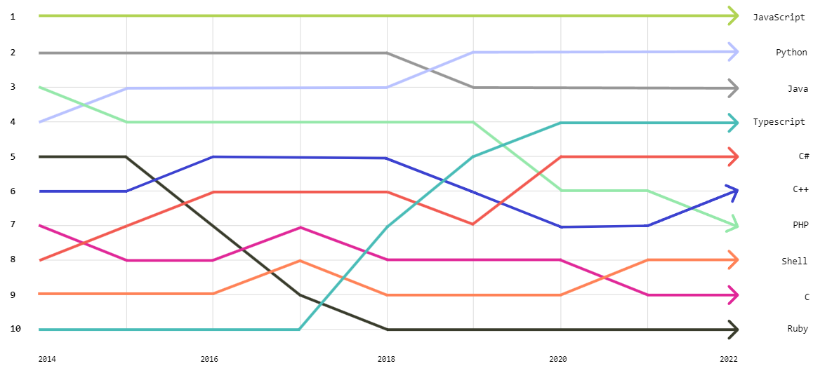
Top languages in recent years by Github
https://octoverse.github.com/2022/top-programming-languages

Slide 23
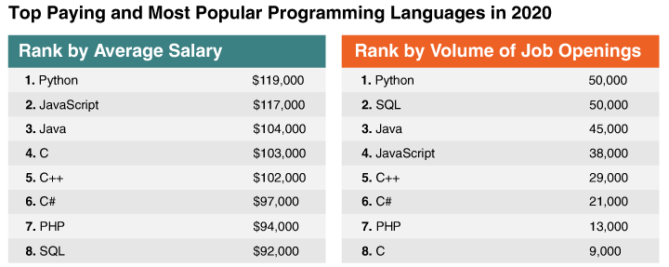
Ranking programming languages by pay and number of openings
https://www.codeplatoon.org/best-paying-most-in-demand-programming-languages-2020/
https://www.codeplatoon.org/the-best-paying-and-most-in-demand-programming-languages/

Slide 24
A brief introduction to web development

Slide 25
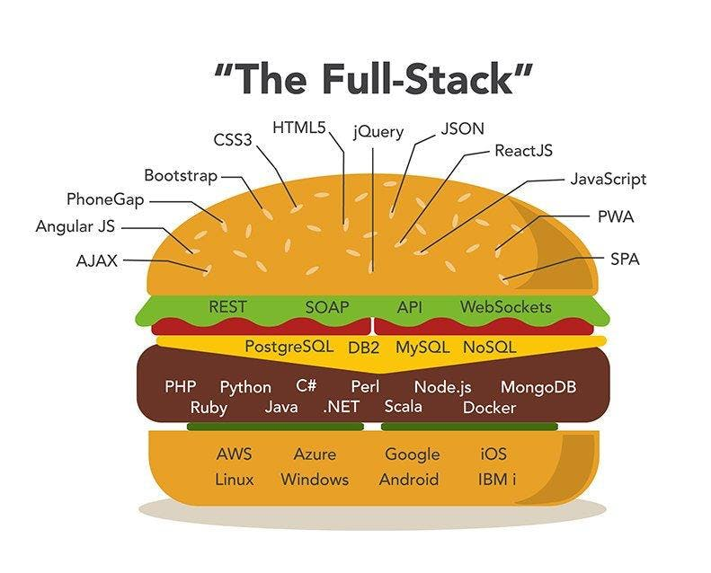
What is Full Stack Development?
Full stack development refers to the development of both front end (client side) and back end(server side) portions of web application.
A full stack web developer is a person who can develop both client and server software.
https://blog.skillsafari.in/full-stack-development-develop-your-pathway-in-2022

Slide 26
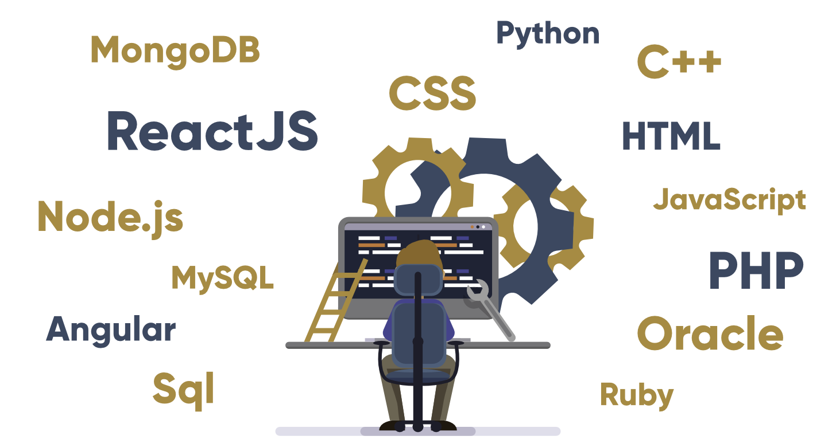
Sample Tools for Full Stack Development
https://www.geeksforgeeks.org/what-is-full-stack-development/

Slide 27
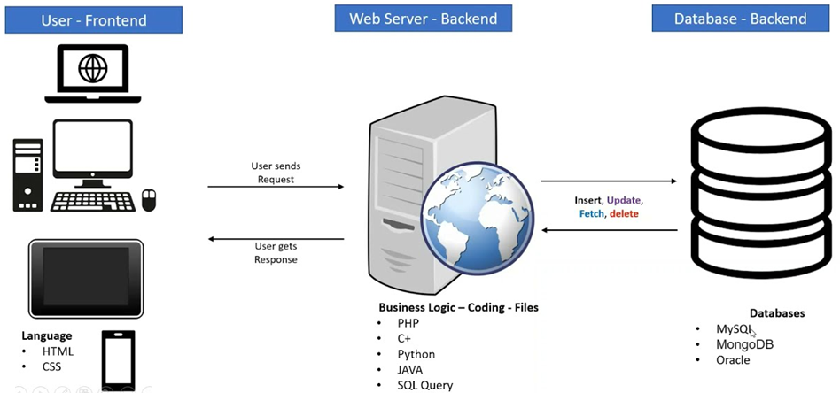
Frond-end vs. Back-end
Front end is the visible part of website or web application which is responsible for user experience. The user directly interacts with the front-end portion of the web application or website.
Back end refers to the server-side development of web application or website with a primary focus on how the website works. It is responsible for managing the database through queries and APIs by client-side commands.

Slide 28
Software: Frond-end vs. Back-end
Client Software (Front End) HTML CSS main technologies JavaScript Bootstrap JSON XML jQuery Angular JS React JS Backbone.js Ember.js Redux Storybook GraphQL Meteor.js Grunt Gulp | Server Software (Back End) PHP ASP C++ C# Java Python Node.js Express.js Ruby REST Go SQL MongoDB
Usually 3 parts:
Server
Application
Database

Slide 29
Front-end Languages
HTML: HTML stands for Hyper Text Markup Language. It is used to design the front end portion of web pages using markup language. HTML is the combination of Hypertext and Markup language. Hypertext defines the link between the web pages. The markup language is used to define the text documentation within tag which defines the structure of web pages.
CSS: Cascading Style Sheets, fondly referred to as CSS, is a simply designed language intended to simplify the process of making web pages presentable. CSS allows you to apply styles to web pages. More importantly, CSS enables you to do this independent of the HTML that makes up each web page.
JavaScript: JavaScript is a famous scripting language used to create the magic on the sites to make the site interactive for the user. It is used to enhancing the functionality of a website to running cool games and web-based software.
https://www.geeksforgeeks.org/what-is-full-stack-development/

Slide 30
Front End Frameworks and Libraries
AngularJS: AngularJs is a JavaScript open source front-end framework that is mainly used to develop single page web applications(SPAs). It is a continuously growing and expanding framework which provides better ways for developing web applications. It changes the static HTML to dynamic HTML. It is an open source project which can be freely used and changed by anyone. It extends HTML attributes with Directives, and data is bound with HTML.
React.js: React is a declarative, efficient, and flexible JavaScript library for building user interfaces. ReactJS is an open-source, component-based front end library responsible only for the view layer of the application. It is maintained by Facebook.
Bootstrap: Bootstrap is a free and open-source tool collection for creating responsive websites and web applications. It is the most popular HTML, CSS, and JavaScript framework for developing responsive, mobile-first web sites.
jQuery: jQuery is an open source JavaScript library that simplifies the interactions between an HTML/CSS document, or more precisely the Document Object Model (DOM), and JavaScript. Elaborating the terms, jQuery simplifies HTML document traversing and manipulation, browser event handling, DOM animations, Ajax interactions, and cross-browser JavaScript development.
SASS: It is the most reliable, mature and robust CSS extension language. It is used to extend the functionality of an existing CSS of a site including everything from variables, inheritance, and nesting with ease.
Some other libraries and frameworks are: Semantic-UI, Foundation, Materialize, Backbone.js, Express.js, Ember.js etc.
https://www.geeksforgeeks.org/what-is-full-stack-development/

Slide 31
Back-end Components
PHP: PHP is a server-side scripting language designed specifically for web development. Since, PHP code executed on server side so it is called server side scripting language.
C++ It is a general purpose programming language and widely used now a days for competitive programming. It is also used as backend language.
Java: Java is one of the most popular and widely used programming language and platform. It is highly scalable. Java components are easily available.
Python: Python is a programming language that lets you work quickly and integrate systems more efficiently.
JavaScript: Javascript can be used as both (front end and back end) programming languages.
Node.js: Node.js is an open source and cross-platform runtime environment for executing JavaScript code outside of a browser. You need to remember that NodeJS is not a framework and it’s not a programming language. Most of the people are confused and understand it’s a framework or a programming language. We often use Node.js for building back-end services like APIs like Web App or Mobile App. It’s used in production by large companies such as Paypal, Uber, Netflix, Walmart and so on.
Back End Frameworks: The list of back end frameworks are: Express, Django, Rails, Laravel, Spring etc.
The other back-end program/scripting languages are: C#, Ruby, REST, GO etc.
https://www.geeksforgeeks.org/what-is-full-stack-development/

Slide 32
Databases
1. The Oracle
Oracle is the most widely used commercial relational database management system, built-in assembly languages such as C, C++, and Java.
2. MySQL
MySQL is one of the most popular databases to use in 2022 in the computer world, especially in web application development. The main focus of this database is on stability, robustness, and maturity. The most popular application of this database is for web development solutions.
3. MS SQL Server
Microsoft provides great toolset support for one of this best database software, both on-premise and in the cloud. It’s attuned well with Linux and Windows systems. MS SQL is a multi-model database that supports Structured Data (SQL), Semi-Structured Data(JSON), and Spatial Data.
4. PostgreSQL
PostgreSQL is a database management system written in C and used by businesses that deal with huge amounts of data. This database management software is used by several gaming apps, database automation tools, and domain registrations.
5. MongoDB
One of most popular NoSQL databases. Mongo was developed to handle Document Data.
and many other DBMS …

Slide 33
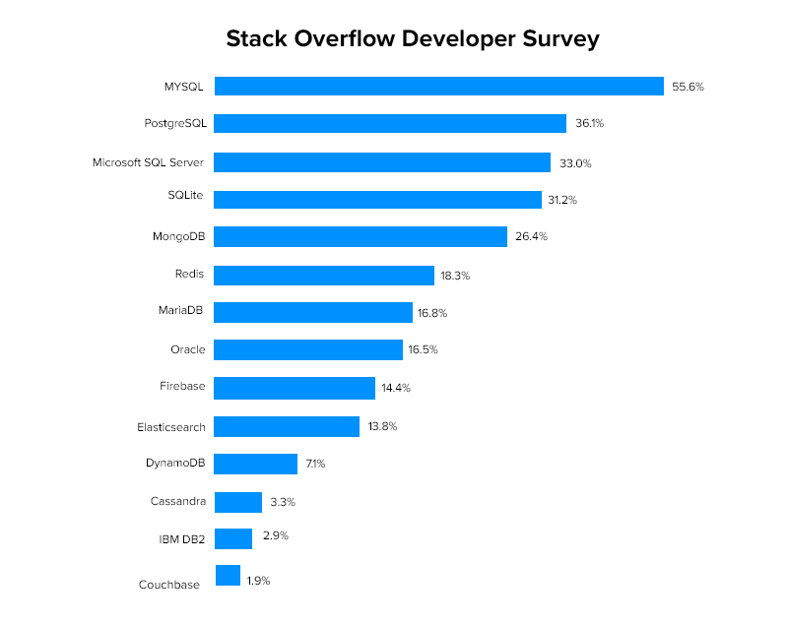
https://appinventiv.com/blog/top-web-app-database-list/

Slide 34
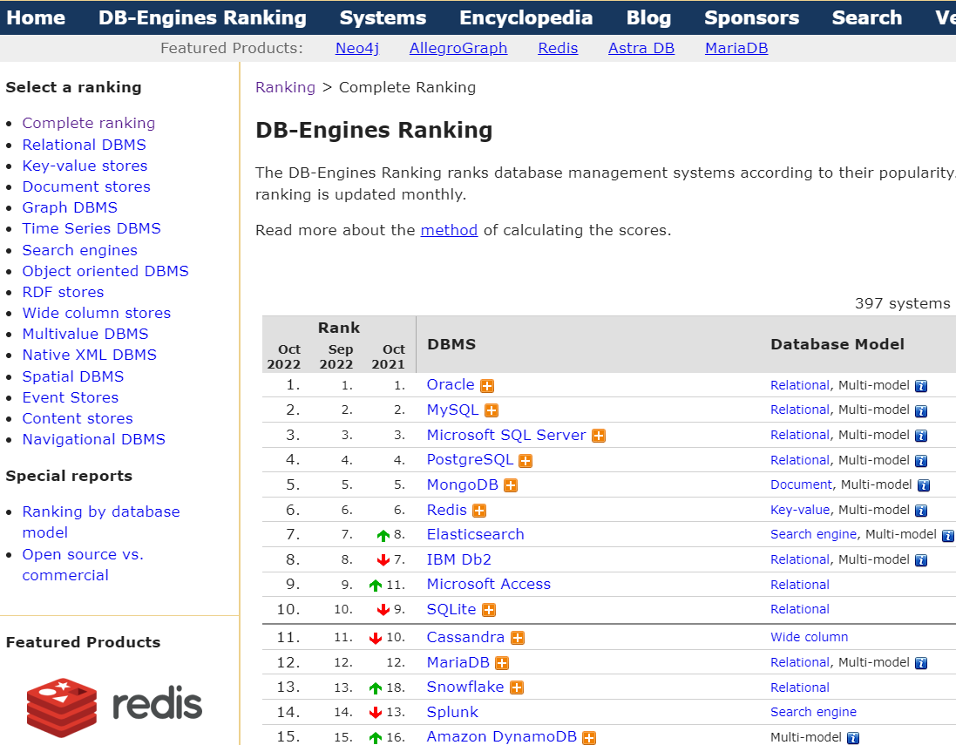
https://db-engines.com/en/ranking

Slide 35
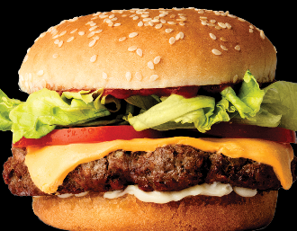
Popular Stacks
A technology stack comprises a bundle of tools, frameworks, technologies, and languages that enable us to develop software solutions, products, mobile and web applications, etc.
LAMP stack:
JavaScript - Linux - Apache - MySQL - PHP
LEMP stack:
JavaScript - Linux - Nginx - MySQL - PHP
MEAN stack:
JavaScript - MongoDB - Express - AngularJS - Node.js
MERN stack:
JavaScript - MongoDB - Express - ReactJS - Node.js
Django stack:
JavaScript - Python - Django - MySQL
Ruby on Rails:
JavaScript - Ruby - SQLite - Rails

Slide 36

Roadmap to Become a Full Stack Developer
Select which stack to use.
LAMP, LEMP, MEAN, MERN, Ruby on Rails
Front-end technology.
Main technologies are HTML,CSS and JavaScript
Backend technology.
Usually 3 parts: a server, an application, and a database
Popular backend frameworks: Express, Django, Ruby on rails
Database management.
MySQL, SQLite, Postgres, MongoDB, etc.
Version control system.
Git, github, gitlab, etc.
Additional skill required.
Linux commands, SSH, Data structures & Algorithms, more
Building your own projects
https://myways.ai/career-wiki/blogs/view/roadmap-to-become-a-full-stack-developer
https://www.raftlabs.co/development/full-stack-developer-complete-roadmap
https://www.youtube.com/watch?v=vgEVfaDmfTk&t=201s (reasons not be a full-stack developer)

Slide 37
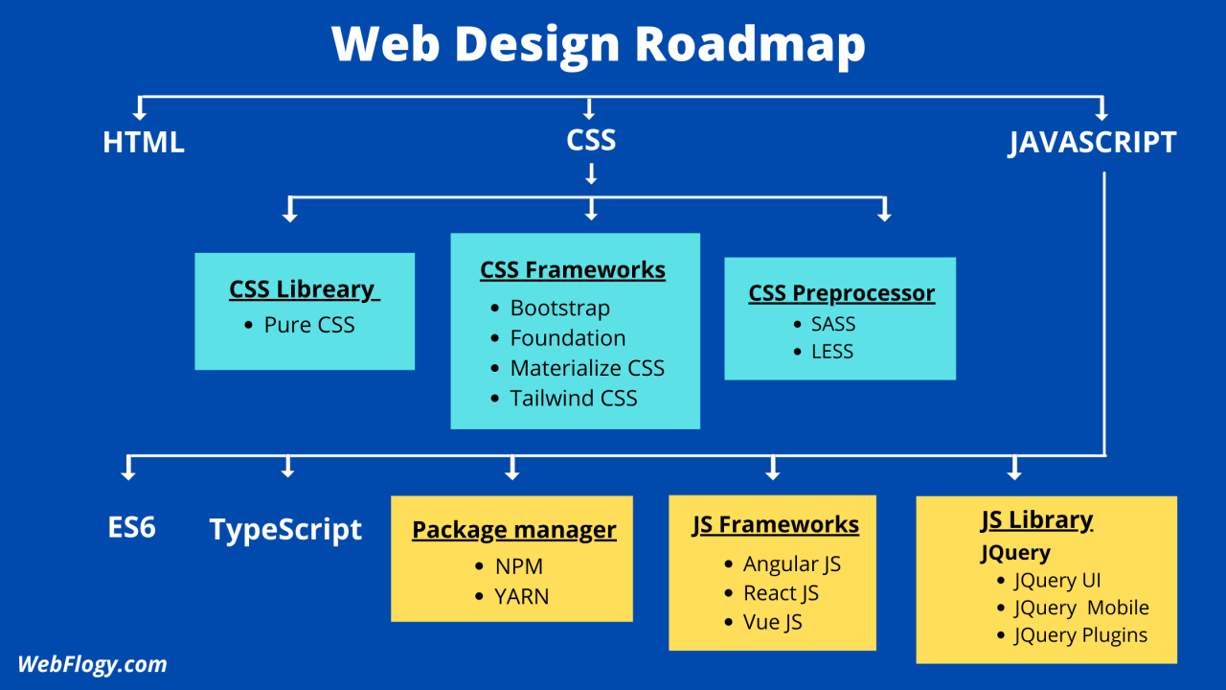
https://www.linkedin.com/pulse/web-design-roadmap-2022-how-front-end-developer-/

Slide 38
Useful Resources
Server-side website programming
https://developer.mozilla.org/en-US/docs/Learn/Server-side
What is full stack development?
https://www.geeksforgeeks.org/what-is-full-stack-development/
DB-engine ranking
https://db-engines.com/en/ranking
Roadmap to full stack developers:
https://myways.ai/career-wiki/blogs/view/roadmap-to-become-a-full-stack-developer
https://www.raftlabs.co/development/full-stack-developer-complete-roadmap

Slide 39
A brief introduction to HTML

Slide 40
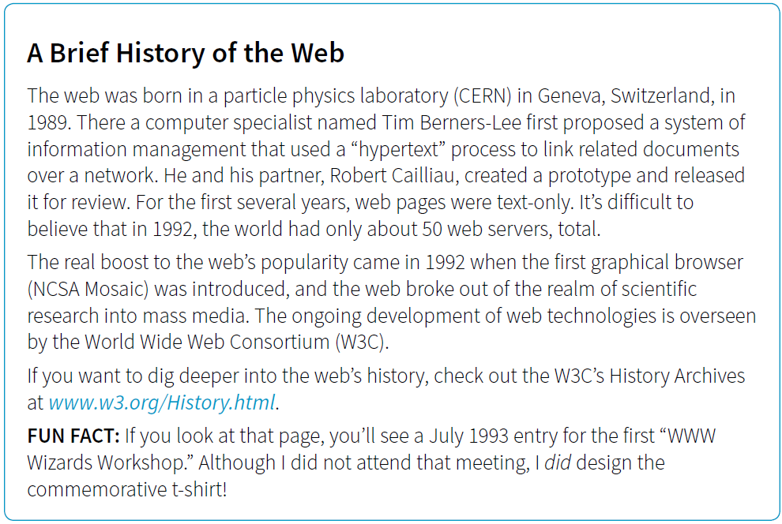
Take a look at the first web site at http://info.cern.ch

Slide 41
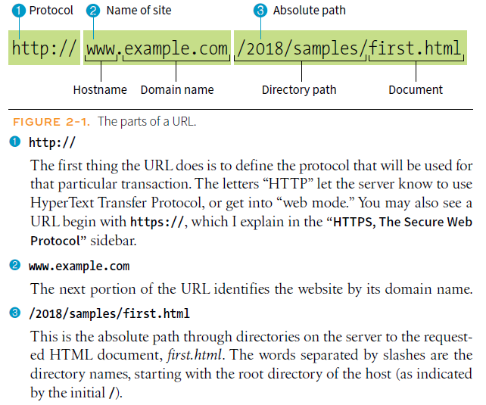

Slide 42
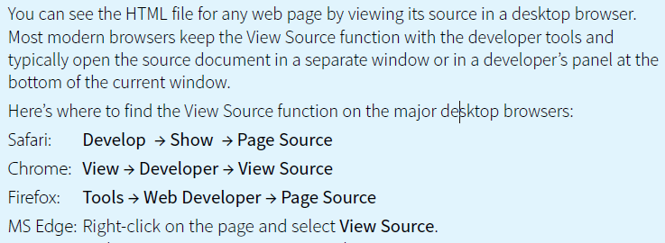
View Source in Web Browsers
1. With the browser of your choice, enter this URL into your browser:
www.learningwebdesign.com/5e/kitchen.html
You should see the Jen’s Kitchen web page from FIGURE 2-3.
2. Follow the directions for your browser listed above to view the source HTML document
for the Jen’s Kitchen page. It should be the same as shown in the figure.
3. To view a page that is a little more complicated, take a look at the source for the learningwebdesign.com home page.

Slide 43

HTML for Structure

Slide 44
What is HTML?
From: https://en.wikipedia.org/wiki/HTML
The HyperText Markup Language or HTML is the standard markup language for documents designed to be displayed in a web browser. It can be assisted by technologies such as Cascading Style Sheets (CSS) and scripting languages such as JavaScript.
Web browsers receive HTML documents from a web server or from local storage and render the documents into multimedia web pages. HTML describes the structure of a web page semantically and originally included cues for the appearance of the document. An example below:
<!DOCTYPE html>
<html>
<head>
<title>This is a title</title>
</head>
<body>
<p>Hello world!</p>
</body>
</html>
https://www.youtube.com/watch?v=ok-plXXHlWw (HTML in 100 Seconds)

Slide 45
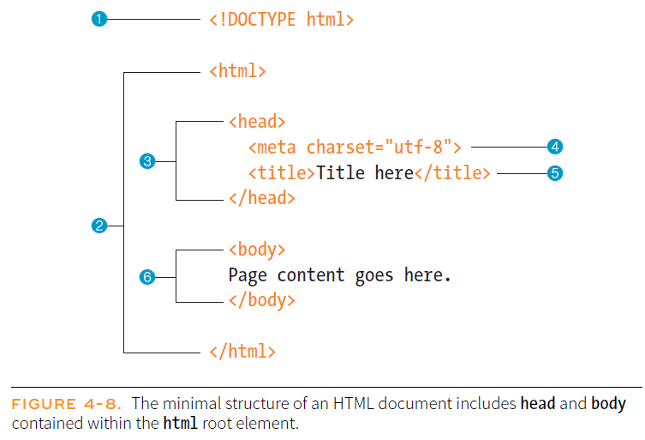
Basic Document Structure

Slide 46
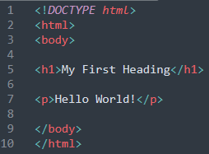
HTML/CSS Editor
Any regular text editor
Windows: notepad
Linux: vi/vim, gedit, nano
Mac: TextEdit
Text editors with more functionalities such as syntax highlighting, auto-completion, error detection etc.
WYSIWYG Editor
Froala, Adobe Dreamweaver, CoffeeCup, Word
Text-based HTML Editor
Atom, Notepad++, Sublime Text, Visual Studio Code,

Slide 47
Chapter 5: Marking Up Text
PARAGRAPHS
<p>…</p>
Paragraph element
Paragraphs are the most rudimentary elements of a text document. Indicate a paragraph with the p element by inserting an opening <p> tag at the beginning of the paragraph and a closing </p> tag after it, as shown in this example:
<p>Serif typefaces have small slabs at the ends of letter strokes. In general, serif fonts can make large amounts of text easier to read.</p>
No Naked Text!
You must assign an element to all the text in a document. In other
words, all text must be enclosed in some sort of element. Text that is not
contained within tags is called naked or anonymous text, and it will cause a
document to be invalid.

Slide 48
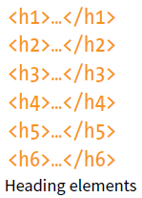
HEADINGS
There are six levels of headings, from h1 to h6. When you add headings to content, the browser uses them to create a document outline for the page. It is a best practice to start with the Level 1 heading (h1) and work down in numerical order, creating a logical document structure and outline.
This example shows the markup for four heading levels.
<h1>Type Design</h1>
<h2>Serif Typefaces</h2>
<p>Serif typefaces have small slabs at the ends of letter strokes.
In general, serif fonts can make large amounts of text easier to
read.</p>
<h3>Baskerville</h3>
<h4>Description</h4>
<p>Description of the Baskerville typeface.</p>
<h4>History</h4>
<p>The history of the Baskerville typeface.</p>
<h3>Georgia</h3>
<p>Description and history of the Georgia typeface.</p>
<h2>Sans-serif Typefaces</h2>
<p>Sans-serif typefaces do not have slabs at the ends of strokes.</p>

Slide 49
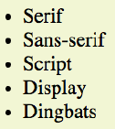
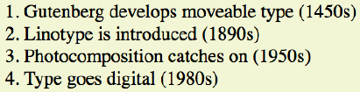
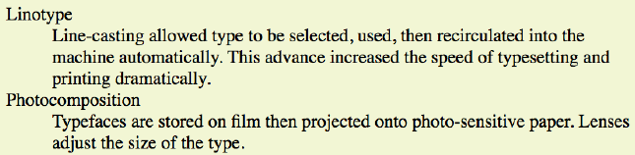
LISTS
Humans are natural list makers, and HTML provides elements for marking
up three types of lists:
Unordered lists
Collections of items that appear in no particular order
Ordered lists
Lists in which the sequence of the items is important
Description lists
Lists that consist of name and value pairs, including but not limited to
terms and definitions

Slide 50
Unordered Lists
By default, unordered lists display with a bullet before each list item, but you can change that with a style sheet, as you’ll see in a moment.
To identify an unordered list, mark it up as a ul element. The opening <ul> tag goes before the first list item, and the closing tag </ul> goes after the last item.
The only thing that is permitted within an unordered list (that is, between the start and end ul tags) is one or more list items
Example:
<ul>
<li>Serif</li>
<li>Sans-serif</li>
<li>Script</li>
<li>Display</li>
<li>Dingbats</li>
</ul>

Slide 51
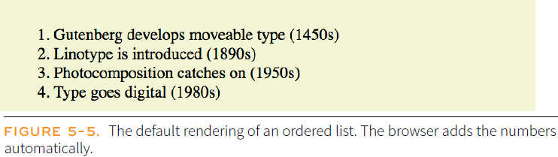
Ordered Lists
Ordered lists are for items that occur in a particular order, such as step-by step instructions or driving directions. They work just like the unordered lists described earlier, but they are defined with the ol element (for “ordered list,” of course). Instead of bullets, the browser automatically inserts numbers before ordered list items. Ordered list elements must contain one or more list item elements.
<ol>
<li>Gutenberg develops moveable type (1450s)</li>
<li>Linotype is introduced (1890s)</li>
<li>Photocomposition catches on (1950s)</li>
<li>Type goes digital (1980s)</li>
</ol>

Slide 52
Description Lists
Description lists are used for any type of name/value pairs, such as terms and their definitions, questions and answers, or other types of terms and their associated information. The content of a dl is some number of dt elements indicating the names, and dd elements for their respective values.
<dl>
<dt>Linotype</dt>
<dd>Line-casting allowed type to be selected, used, then recirculated
into the machine automatically. This advance increased the speed of
typesetting and printing dramatically.</dd>
<dt>Photocomposition</dt>
<dd>Typefaces are stored on film then projected onto photo-sensitive
paper. Lenses adjust the size of the type.</dd>
<dt>Digital type</dt>
<dd><p>Digital typefaces store the outline of the font shape in a
format such as Postscript. The outline may be scaled to any size for
output.</p>
<p>Postscript emerged as a standard due to its support of
graphics and its early support on the Macintosh computer and Apple
laser printer.</p>
</dd>
</dl>

Slide 53
Preformatted Text
Web browsers ignore whitespace such as line returns and character spaces in the source document.
But in some types of information, such as code examples or certain poems, the whitespace is important for conveying meaning.
Text in a <pre> element is displayed in a fixed-width font, and the text preserves both spaces and line breaks. The text will be displayed exactly as written in the HTML source code.
<pre>
This is an example of
text with a lot of
curious
whitespace.
</pre>

Slide 54
Headers
The header element is used for introductory material that typically appears at the beginning of a web page or at the top of a section or article.
<body>
<header>
<h1>Nuts about Web Fonts</h1>
<nav>
<ul>
<li><a href="/">Home</a></li>
<li><a href="/">Blog</a></li>
<li><a href="/">Shop</a></li>
</ul>
</nav>
</header>
<!--page content-->
</body>

Slide 55
Sections and Articles
To divide long web documents into thematic sections, use the aptly named section element. Sections typically include a heading (inside the section element) plus content that has a meaningful reason to be grouped together.
<section>
<h2>Typography Books</h2>
<ul>
<li>…</li>
</ul>
</section>
<section>
<h2>Online Tutorials</h2>
<p>These are the best tutorials on the web.</p>
<ul>
<li>…</li>
</ul>
</section>
Use the article element for self-contained works. A long article could be broken into a number of sections.

Slide 56
Chapter 6: Adding Links
The <a> HTML element (or anchor element), with its href attribute, creates a hyperlink to web pages, files, email addresses, locations in the same page, or anything else a URL can address.
Content within each <a> should indicate the link's destination. If the href attribute is present, pressing the enter key while focused on the <a> element will activate it.
Examples:
<a href="http://www.oreilly.com">Go to the O'Reilly Media site</a>
<a href="http://www.oreilly.com"><img src="tarsierlogo.gif"
alt="O'Reilly Media site"></a>

Slide 57
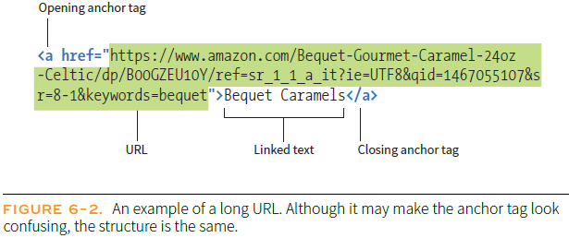
The HREF Attribute
The href (hypertext reference) attribute provides the address of the page or resource (its URL) to the browser. The URL must always appear in quotation marks.
Most of the time you’ll point to other HTML documents; however, you can also point to other web resources, such as images, audio, and video files.
There are two ways to specify URL:
Absolute URLs provide the full URL for the document, including the protocol (http:// or https://), the domain name, and the pathname as necessary.
Relative URLs describe the pathname to a file relative to the current document

Slide 58
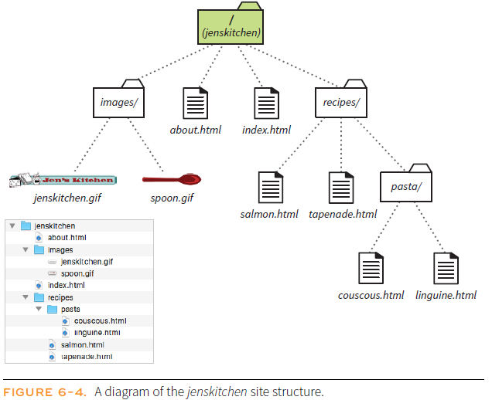
Linking Within Own Site
A large portion of the linking you do is between pages of your own site: from the home page to section pages, from section pages to content pages, and so on. In these cases, you can use a relative URL—one that calls for a page on your own server.

Slide 59
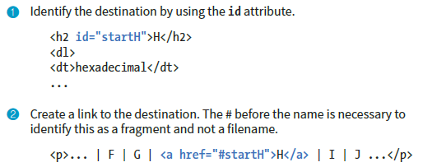
Linking to a Specific Point in a Page
Step 1: Identifying the destination
To create a destination, use the id attribute to give the target element in the document a unique name (that’s “unique” as in the name may appear only once in the document, not “unique” as in funky and interesting). In web lingo, this is the fragment identifier.
Step 2: Linking to the destination

Slide 60
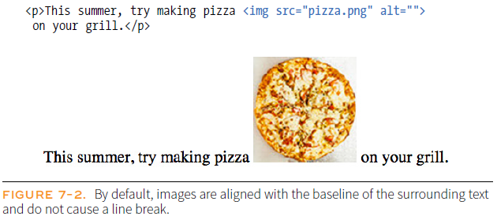
Chapter 7: Adding Images
The img element tells the browser, “Place an image here.”. The img element is what’s known as a replaced element because it is replaced by an external file when the page is displayed.
The src (source) attribute provides the location of the image file (its URL). The alt attribute provides alternative text that displays if the image is not available.

Slide 61
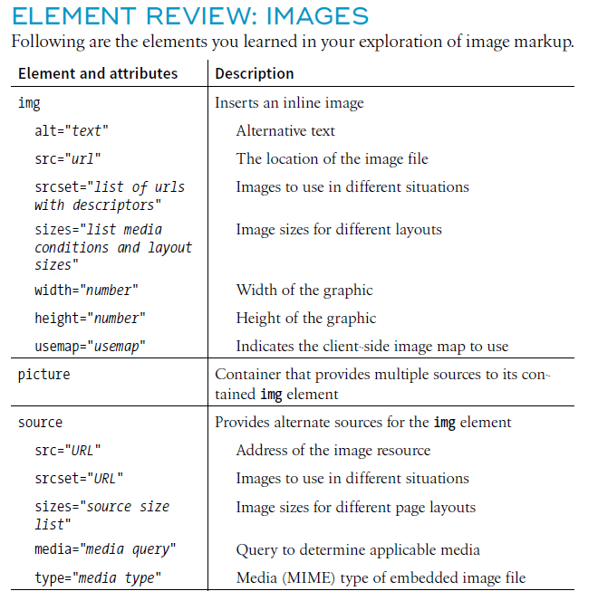

Slide 62
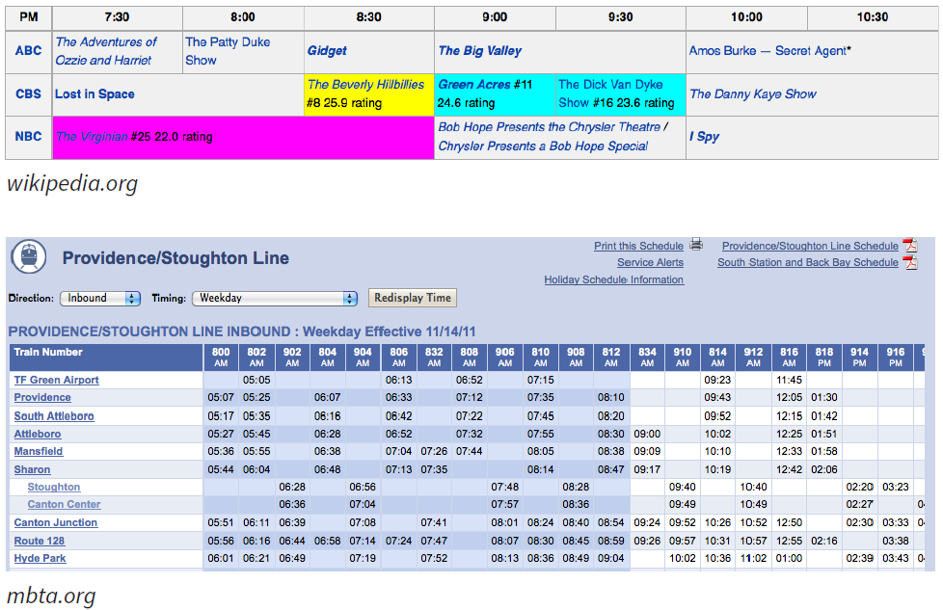
Chapter 8: Table Markup
Table examples:

Slide 63
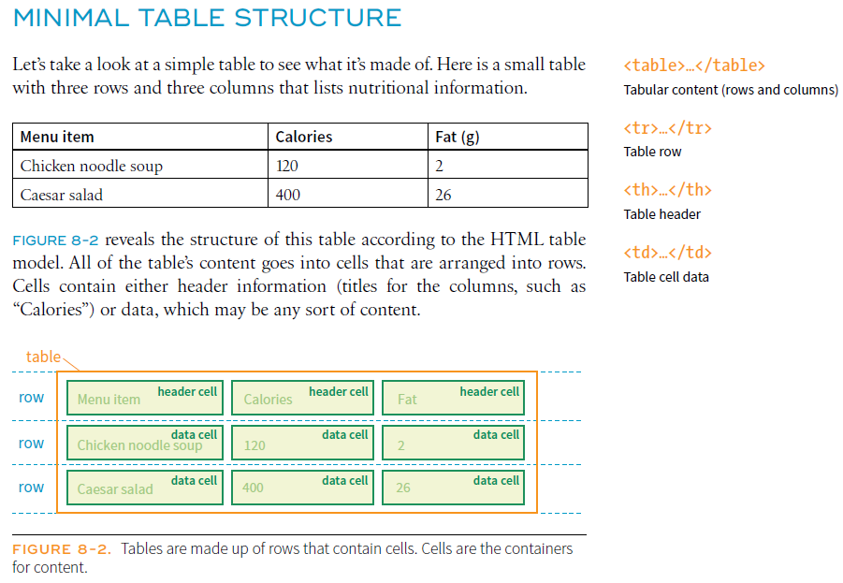
Minimum Table Structure

Slide 64
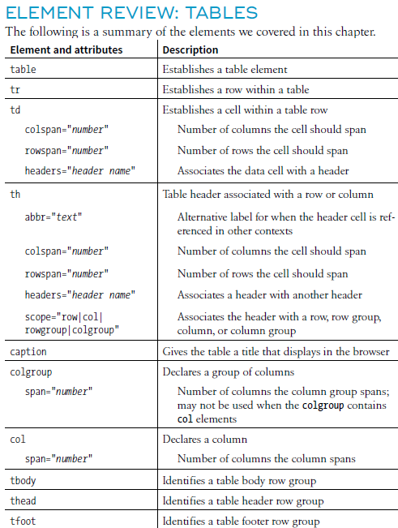
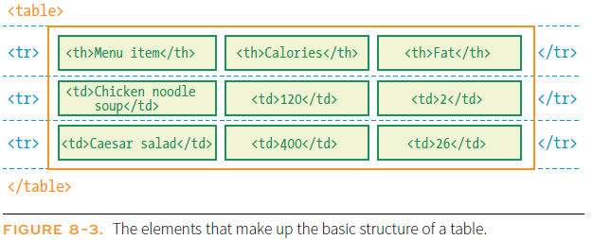
<table>
<tr>
<th>Menu item</th>
<th>Calories</th>
<th>Fat (g)</th>
</tr>
<tr>
<td>Chicken noodle soup</td>
<td>120</td>
<td>2</td>
</tr>
<tr>
<td>Caesar salad</td>
<td>400</td>
<td>26</td>
</tr>
</table>

Slide 65
Chapter 9: Forms
There are two parts to a working form.
The first part is the form that you see on the page itself that is created using HTML markup. Forms are made up of buttons, input fields, and drop-down menus (collectively known as form controls) used to collect information from the user. Forms may also contain text and other elements.
The other component of a web form is an application or script on the server that processes the information collected by the form and returns an appropriate response. It’s what makes the form work. In other words, posting an HTML document with form elements isn’t enough. Web applications and scripts require programming know-how that is beyond the scope of this book.

Slide 66
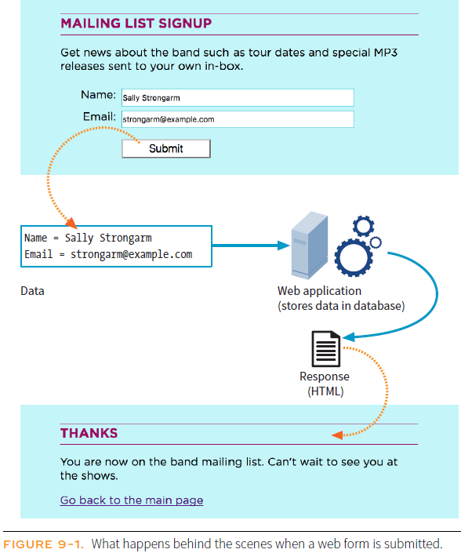
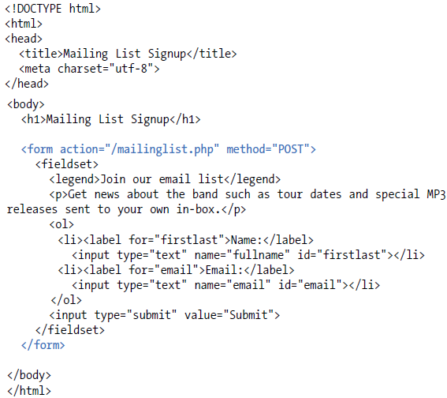
How forms work

Slide 67
Useful Resources
World Wide Web Consortium (W3C)
https://www.w3.org/
HTML Specs W3C
https://www.w3.org/TR/2011/WD-html5-20110405/
HTML: HyperText Markup Language
https://developer.mozilla.org/en-US/docs/Web/HTML
HTML Tutorials
https://www.w3schools.com/html/
https://www.tutorialspoint.com/html/index.htm
https://developer.mozilla.org/en-US/docs/Learn/HTML/Introduction_to_HTML

